Slide 1
Final Presentation- College Expansion
Junyan Yao
May 8th, 2017

Slide 2
Recap
Project Question:
Predict whether to open a new college or not in one area;
Who cares?
The local government agents
What a success will look like?
By using the past data to predict if this area will have a new campus open.
Notes:
I will start with my project question. Since lots of communications and feedbacks. I think my project interests get more clear. I think predicting whether it is significantly necessary open a new college in one area seems very awesome. And local government agents and other campus-related programs will be interested. The final success of the project would be using the past data to predict the likelihood or odds ratio if this area will have a new campus open in the next a few years.

Slide 3
Outline
Recap of midterm
Data Analysis
Next Step
Notes:
Since the midterm, I am working on the model fitting. I am kind of lost during this process. I am frustrated here. Then I am back to my data. I think I am not very familiar with my data before midterm. So I am back on diging into the data. And find possible model options. In the final part, I will talk about the next step of this project.

Slide 4
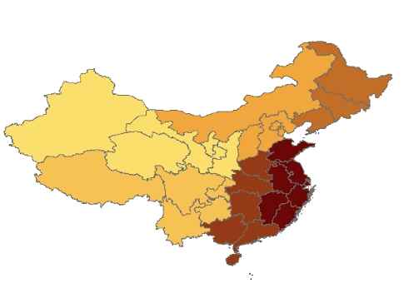
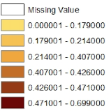
Data
Increases in the number of campuses by region
Panel Data
1985-2011
Across all regions in mainland China;
Campus dataset: number of campuses, number of comprehensive campuses, level of campuses…
Economic dataset: GDP per capita, population, Foreign direct investment, worker’s average wage…
Notes:
This is just a recap of my data. My data is in panel form. It dated from year 1985 to 2011. Across all regions. I have cityids and data for county level. This data was formed by two parts- the education database and ecnomic database.

Slide 5
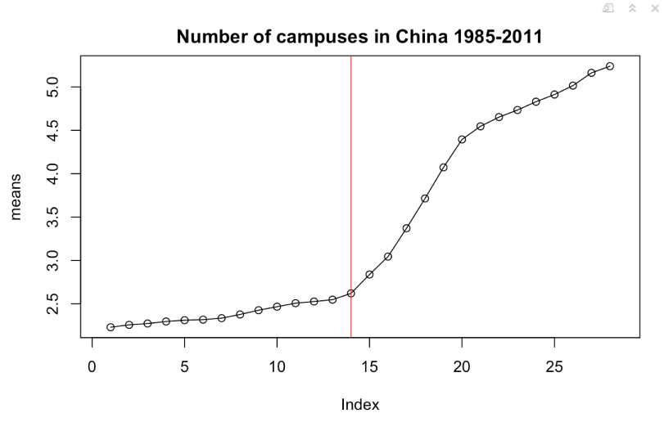
Summary Statistics: Split the data to pre-expansion and expansion
Note: Red line indicates year of 1999.
Notes:
This slide visualized the growth trends of the average number of campuses in China from 1985 to 2011. Xaix did not label very well. But it did not hurt. The red line indicates the year of 1999. This is the cut off point I selected. I think it makes sense for me to say before 1999, it is pre-expansion and after 1999, it is expansion. This is very useful in digging around my datasets.

Slide 6
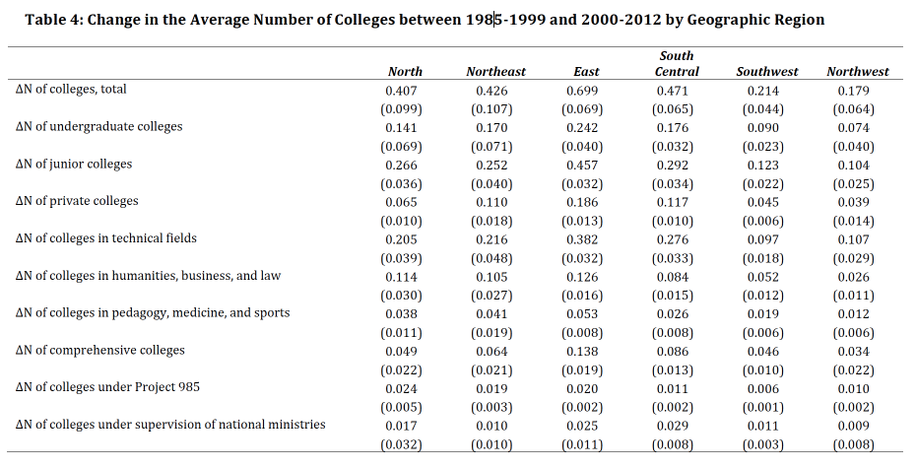
Summary Statistics: by Geographic Region
Notes:
I have made several tables to illustrate my data in different degrees. This table shows the change of different kinds of campuses by geographic regions. The geographic region was defined my Chinese government. I recoded them using province id. I can feel most of things happened in East area.

Slide 7
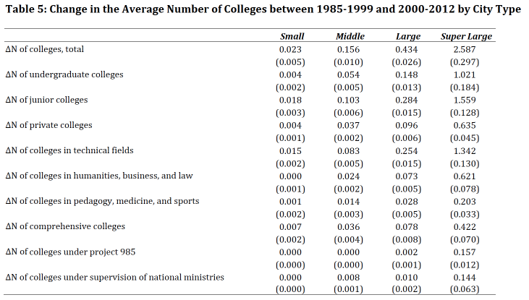
Summary Statistics: By Population Size
Small City: lower than 200,000 persons;
Middle City: 200,000- 500,000 persons;
Large City: 500,000- 10,000,000 persons;
Super large city: over 10,000,000 persons;

Slide 8
Summary Statistics Real GDP Movement by Regions-Prefecture level
#1- North; 2- Northeast; 3- East; 4-South Central; 5- Southwest; 6- Northwest;

Slide 9
Summary Statistics Real GDP Movement by Regions-Urban Core
#1- North; 2- Northeast; 3- East; 4-South Central; 5- Southwest; 6- Northwest;

Slide 10
Model Consideration
Multiple Regression model:
Pros: did not consider any year effect;
Cons: easy to implement it;
Logistics Regression model:
Same with OLS
Multi level regression
Treat as hierarchical structure, city type, province…
Treat year as one predictor
Tentative: Penalized Regression
Notes:
A large amount of effort has gone into the development of penalized regression methods for variable selection and coefficient estimation. Besides this model can have better prediction in the face of multicollinearity problems especially when we have large numbers of predictors.

Slide 11


Penalized Regression
Propose the elastic net, a regularization and variable selection method;
Consider the usual linear regression model:
But for Elastic Net:
The lambda term is a hyper parameter and is estimated using cross validation.
Use caret package
Notes:
This has the effect of shrinking the coefficient values (and the complexity of the model) allowing some coefficients with minor contribution to the response to get close to zero.

Slide 12
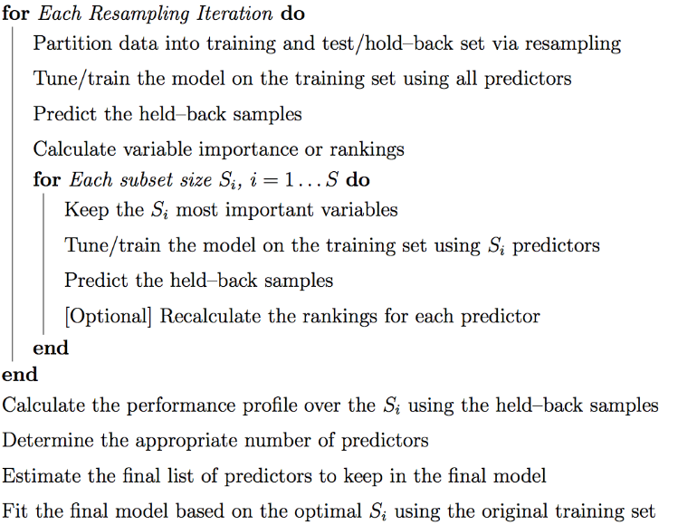
Big Picture of the model fitting
Notes:
Reference: http://citeseerx.ist.psu.edu/viewdoc/download?doi=10.1.1.168.1655&rep=rep1&type=pdf

Slide 13
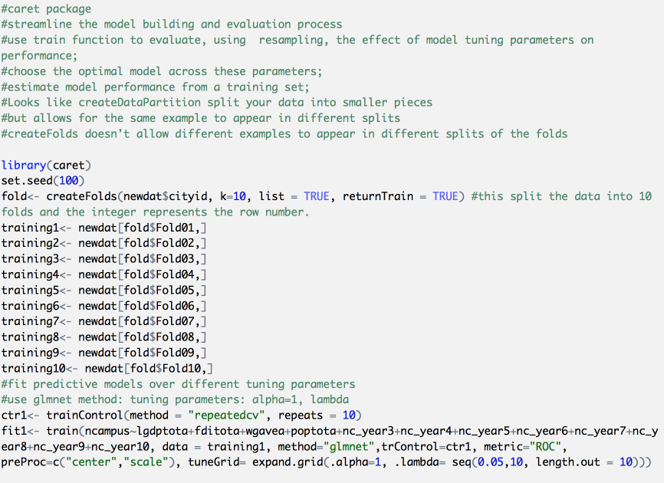

Slide 14
Next Step
R implementation of Elastic Net model, but I am stuck with training the model on training sets with all predictors. The problems is the missing values in my dataset. I will need to do some imputation in missing data(that’s one option to deal with missing data). This is not the model fitting problems. This is data pre-processing problems.

Slide 15

Comments/Questions?

